Slide 1
Welcome and Intro
Jonathan Kovacs

Slide 2
Welcome!

Slide 3
Overview of the Day
Time | Title | Presenter
9:30am – 10:00am | Introduction / Welcome / Kick-off | Jonathan Kovacs, Saurabh Pimpalgaonkar & Sam Balaz
10:00am – 11:00am | Intro to Power Apps Portals | Nick Doelman
11:00am – 12:00pm | Explore the new Designers and Controls in the UUI for Dynamics 365 and Model Driven Apps | Todd Mercer
12:00am – 1:00pm | Lunch
1:00pm – 2:00pm | Introduction to Azure Function Apps with Power Apps | Saurabh Pimpalgaonkar
2:00pm – 3:00pm | Deep Dive: Integrating Power Apps Portals with Microsoft Face API | Jonathan Kovacs
3:00pm – 4:00pm | AI for Everyone: Intro to the AI Builder on the Power Platform | Nick Doelman
4:00pm – 4:30pm | Wrap Up / Swag / Giveaways | Jonathan Kovacs & Saurabh Pimpalgaonkar

Slide 4
Housekeeping - WiFi
WiFi - <wifi details>

Slide 5
Housekeeping - Refreshments
Coffee/Tea/Beverages are available on the left. Please help yourselves.
Lunch is provided courtesy of KingswaySoft. Vegetarian / Gluten-free options are available.

Slide 6
Housekeeping - Restrooms
Out the door, first left, follow the signs.

Slide 7
Housekeeping – In/Out
Doors at reception are locked. If you need to leave and return, please text the numbers on the door to be let back in.

Slide 8
Housekeeping – Other Concerns
If you have any issues or concerns, Saurabh and I are here to assist.

Slide 9
Opening Remarks
Sam Balaz

Slide 10
Kudopalooza Time!

Slide 11
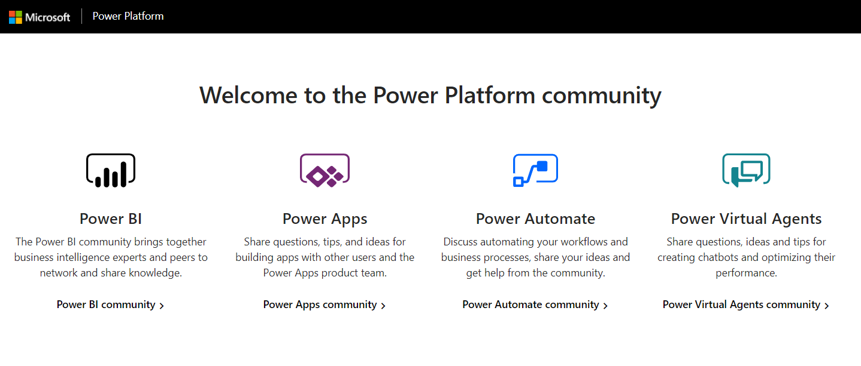
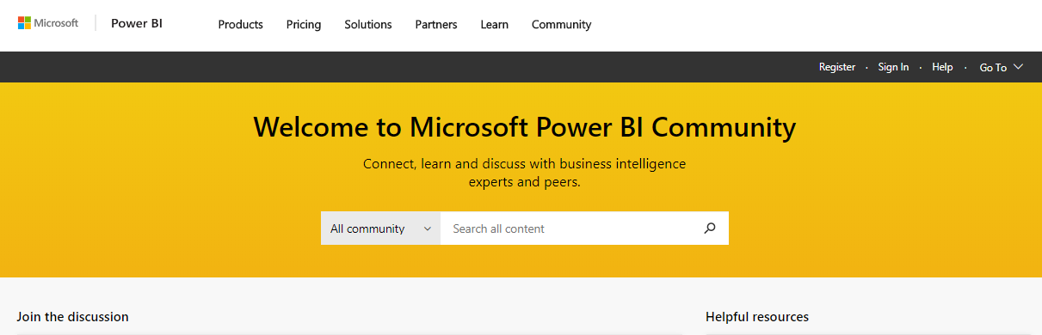

Kudopalooza for SWAG
Navigate to the community:
2. Click Register / Sign In*
3. Search for your event name
4. Click on the post for this event to open it
5. Kudo the post (click the thumbs up) for a chance to win a prize
Community.PowerPlatform.com
1
2
3
*You must Register and sign in to join the fun!

Slide 12



Thank you to our Sponsors!

Slide 13
Any Questions?

